Slide 1
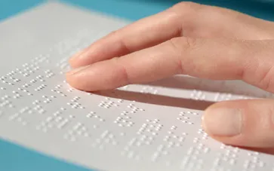
 |  | BRAILLE TO SPEECH CONVERSION FOR DISABLED PERSONS USING PYTHON Under the guidance of Dr. V. V. Rathi

Slide 2
 |  | INTRODUCTION: Individuals with visual impairments rely heavily on assistive technologies to interact with the world around them .Braille, a tactile writing system that allows blind and partially sighted people to read and write through touch . One such solution is the conversion of Braille to speech. A Braille to speech conversion system uses advanced technologies to enable visually impaired individuals to hear written content. The development of a Braille to speech conversion system combines multiple fields of technology, including image processing and machine learning, to translate tactile Braille symbols into audible speech. Capture Images: Use a camera to capture images of Braille text. Image Processing: Process the images to recognize the raised-dot patterns of Braille. Pattern Recognition: Decode the recognized Braille patterns into corresponding text. Text-to-Speech Conversion: Convert the decoded text into audible speech using a text-to-speech engine. Python Integration: Utilize Python and its libraries for image processing and text-to-speech conversion.

Slide 3
 |  | UPDATES TILL NOW: Braille-to-speech conversion systems have been explored for years, Traditional Braille-to-speech systems rely on costly and proprietary hardware, making them inaccessible to many, especially in developing countries. Recent advancements in machine learning, computer vision, and image processing offer new, cost-effective solutions. Several image processing techniques have been used to recognize Braille characters, including edge detection, pattern recognition, and machine learning-based classification. In addition, the availability of powerful text-to-speech libraries in Python enables seamless integration of recognized text into speech.

Slide 4
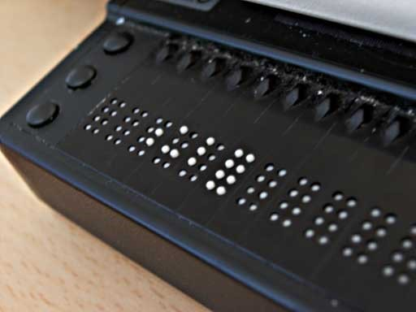
 |  | LITERATURE REVIEW : A customized CNN model proposed based on Braille Character dataset which has 26 different classes of all Alphabets. The primary goal is to use optical character recognition and text-to-speech conversion to achieve the conversion of text in photographs to voice. The device which consists a camera captures an image of any page in a book, detects the text and converts this text into audio and also into refreshable Braille characters, in reality. A living assistance system proposed, which integrates object recognition, object extraction, outline generation, and braille conversion algorithms, that is applicable both indoors and outdoors. The projects ultimate goal is to assist visually challenged persons with text recognition. This goal is accomplished by creating a module that converts text into speech and speaks it through the provided headphone/speaker.

Slide 5
 |  | SCOPE OF WORK : The project focuses on creating a Python-based system that: 1)Recognizes Braille patterns through tactile input or image processing. 2) Converts these patterns into corresponding text. 3)Uses text-to-speech (TTS) technology to generate speech output.

Slide 6
 |  | OBJECTIVES : To study and explore the various techniques for Braille to speech conversion. To design a system that converts Braille into speech in real-time. To enhance the accessibility of communication for visually impaired individuals. To provide an affordable and efficient solution using Python, Open CV and open-source platform. To simulate and verify the operation of proposed system.

Slide 7
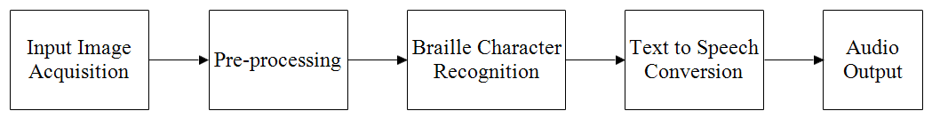
 |  | METHODOLOGY : The proposed Braille-to-speech system consists of the following key components with blocks defined in figure :

Slide 8
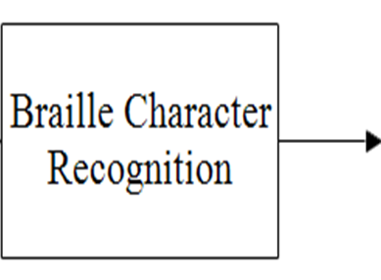
 |  | The system begins by capturing an image of the Braille text using a camera. The quality of the image is critical for accurate recognition, so a high-resolution camera is recommended. The image is then passed to the preprocessing stage. The captured image is preprocessed to enhance clarity and contrast using image processing techniques such as grayscale conversion, thresholding, and noise reduction. The preprocessed image is analyzed using edge detection algorithms such as Canny or Sobel. Contours are extracted to identify the position and structure of the raised Braille dots. The system compares the detected patterns with a stored database of Braille patterns to match the dot to to corresponding characters. Each six-dot Braille cell is mapped to its corresponding letter, number, or symbol.

Slide 9
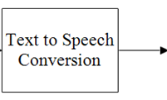
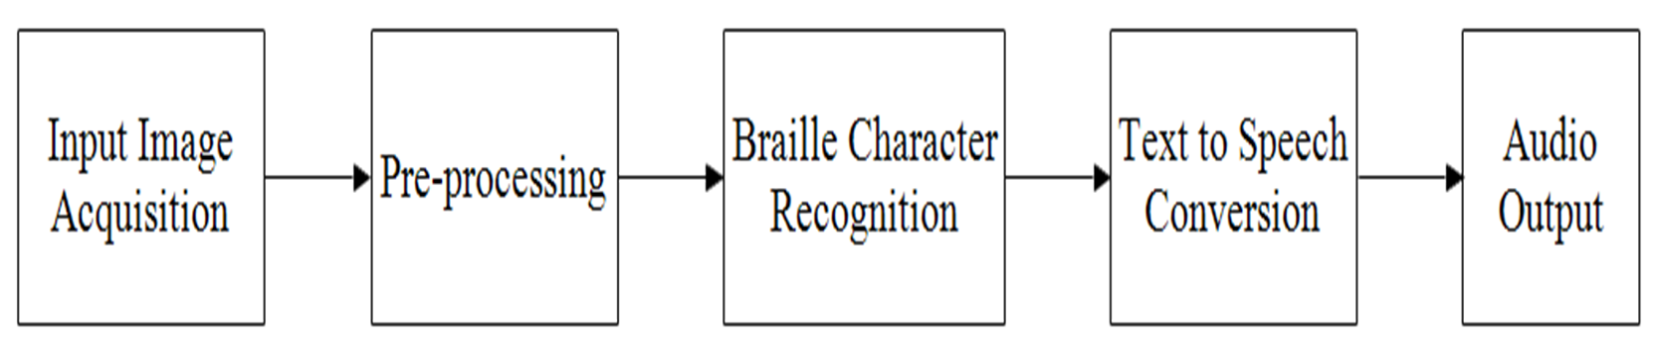
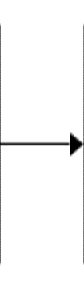
 |  | . Once the Braille characters are identified and converted into text, the system uses a text-to-speech engine to generate spoken output. Python's pyttsx3 or gTTS libraries provide the text-to-speech functionality transforming the recognized text into audible speech. The speech output can be adjusted for different languages, accents, or speeds to suit the user's preference. The generated speech is played back to the user via speakers or headphone

Slide 10
 |  | ADVANTAGES : Increased Accessibility: The system allows visually impaired individuals to access printed materials audibly, removing the need for traditional Braille literacy and making information more accessible. Cost-Effective Solution: Using Python and image processing for Braille conversion eliminates the need for expensive Braille-to-text hardware devices, providing a software-based, cost-effective solution . Portability and Ease of Use: A Python-based system can run on everyday devices such as smartphones or tablets, making it portable and convenient for visually impaired users to use anywhere. Efficient Processing: The combination of image processing and Python’s computational capabilities ensures quick conversion from Braille to speech, improving the reading experience for users .

Slide 11
 |  | DISADVANTAGES : Image Quality Dependency: The accuracy of Braille conversion depends heavily on the quality of the captured images. Poor lighting, image blur, or distortions could lead to errors in recognizing Braille symbols. Limited Accuracy with Complex Braille Structures: While the system works well with standard Braille, more complex Braille formats or symbols (e.g., mathematical or scientific notations) may pose challenges for accurate detection and conversion. Language Limitations: Depending on the implementation, the system may initially be limited to certain languages or regions, requiring additional development to support multi-language Braille conversion. Environmental Constraints: Environmental factors such as lighting, noise, and background objects may interfere with accurate image capture and affect the quality of speech conversion.

Slide 12
 |  | TOOLS AND TECHNOLOGIES Python Programming Language Libraries: OpenCV (for image processing), gTTS or pyttsx3 (for speech generation) Braille Keypad or Image Processing for Braille Recognition.

Slide 13
 |  | EXPECTED OUTCOMES : A working prototype that can effectively translate Braille input into speech. Improved communication for visually impaired individuals. A cost-effective and accessible solution for educational or personal use.

Slide 14
 |  | CONCLUSION/IMPLICATIONS : This project aims to develop a Python-based Braille-to-speech conversion system using image processing and text-to-speech technologies. The system captures and recognizes Braille characters from images, converting them into speech. It provides an affordable and accessible solution for visually impaired individuals, enhancing their communication and access to information. The proposed system is user-friendly and cost-effective, improving communication abilities for the visually impaired community.

Slide 15
 |  | FUTURE WORK : Expansion to multi-lingual Braille-to-speech conversion. Integration with other assistive technologies, such as speech recognition. Development of mobile applications for increased accessibility. Integration of real-time Braille-to-speech conversion via wearable devices. Support for multi-lingual Braille recognition and speech generation. Optimizing the system for mobile platforms to increase accessibility.

Slide 16
 |  | THANK YOU!

